Slide 1
REVIEW 3. Understanding Demand

Slide 2
State the law of demand.
The law of demand states that consumers buy more of a good when its price decreases.
Conversely, consumers buy less of a good when its price increases.
Consumers love low prices.

Slide 3
Provide an example of the substitution effect.
When the price of orange juice rises, consumers substitute cheaper apple juice for orange juice.

Slide 4
What is a demand schedule?
A demand schedule records the quantity
demanded at various prices.

Slide 5
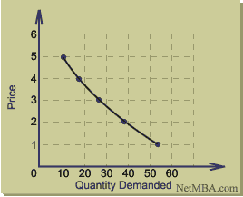
What is a demand curve?
A demand curve is a representation of
Demand schedule displayed on a graph.

Slide 6
How does the income effect lead to the law of demand?
The income effect is the change in consumption resulting from a change in income.
In other words, when prices rise, your money buys less.
Higher prices reduce your purchasing power. This equals a drop in demand.

